Slide 1
Assignment 03 Helper slides

Slide 2
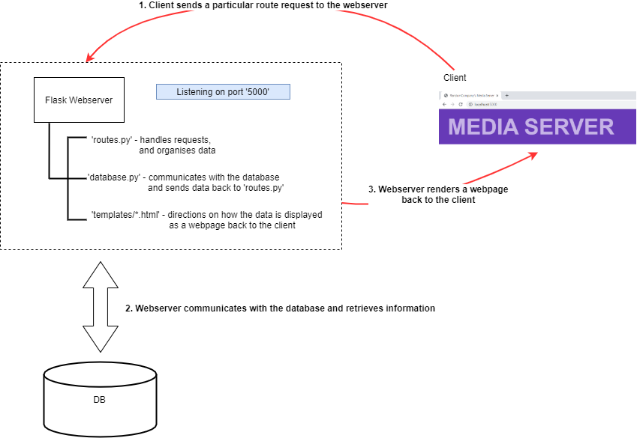
How does the system work?

Slide 3
What do you have to do?
Complete the database handling functions in ‘database.py’ (10 tasks)
Complete the route handing functions in ‘routes.py’ (5 tasks corresponding to 5 of the database handling tasks)
Complete the template displays in ‘templates/*.html’ (4 tasks corresponding to the route handing tasks)
If you complete just the 10 tasks for 1), you can get up to 5/15
If you complete all 20 tasks, you can get up to 8/15
To get the addition 3 marks, you must implement a new functionality, this will involve ALL of the following:
Create a new function in ‘database.py’
Create a new function in ‘routes.py’
Create a new template in ‘templates/*.html’
Add the appropriate menu items in ‘templates/top.html’

Slide 4
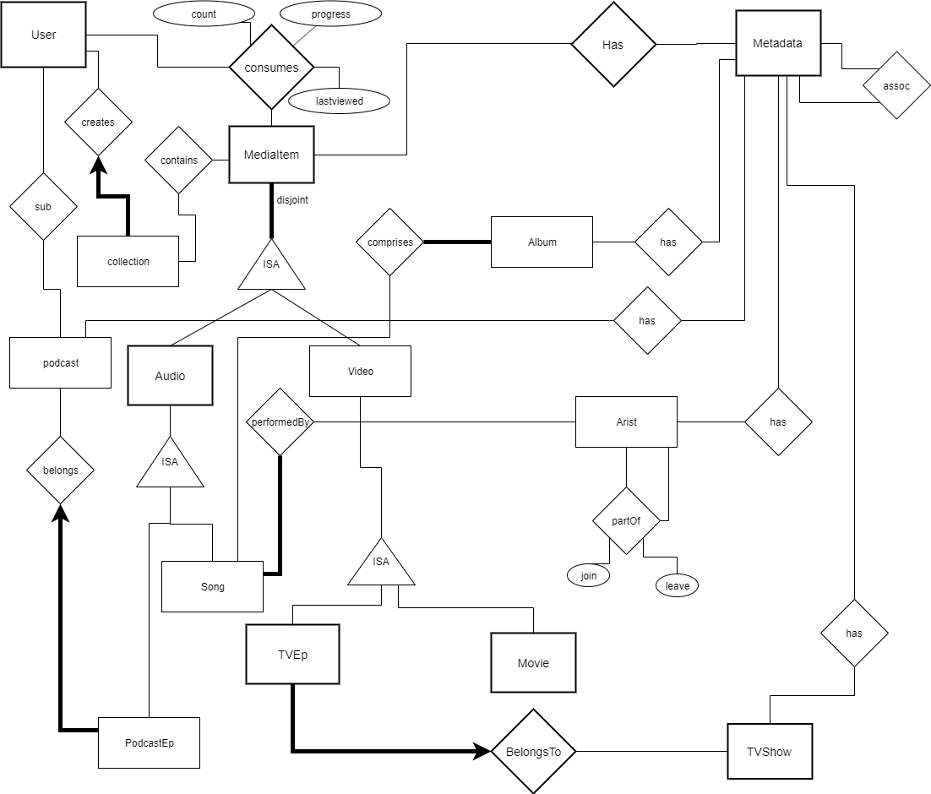

Slide 5
OMG That ERD looks whack
It looks very complicated, but most of that is due to the meta-data system.
Metadata is basically information about data. In this schema we use a series of metadata tables to store information about our various users, media items and how they are organised.

Slide 6
The Metadata system
Why design the system like this?
This metadata system lets us increase the dimensionality of the information we store regarding a media item without having to alter our schema. Instead, we introduce new types of entries into the metasystem and then use a (type,value) system.
How will this affect my queries?
To get information about a media item, you will need to join it to it’s corresponding metadata table. Since different media items might have different (or no) metadata, this is likely means using a left outer join. You can find some examples in the assignment codebase.

Slide 7
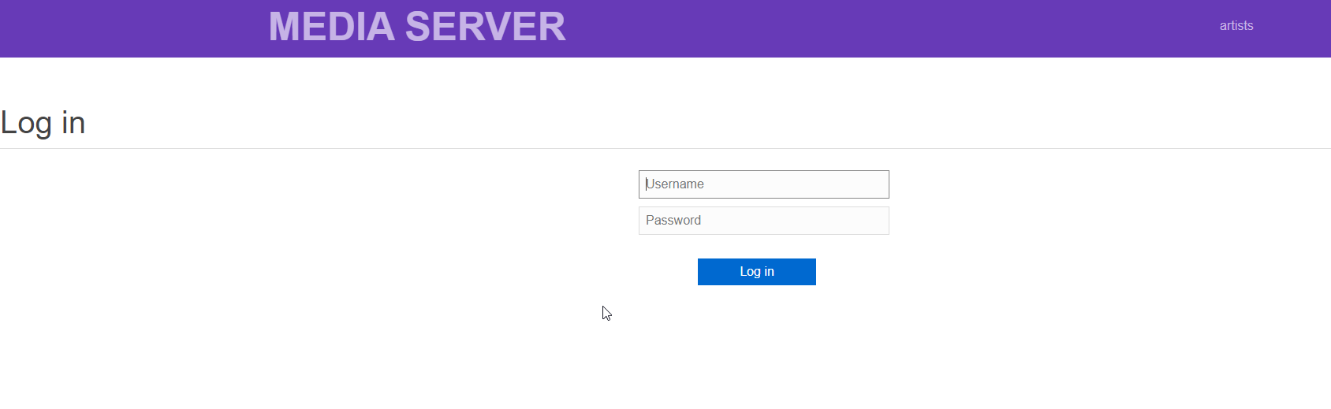
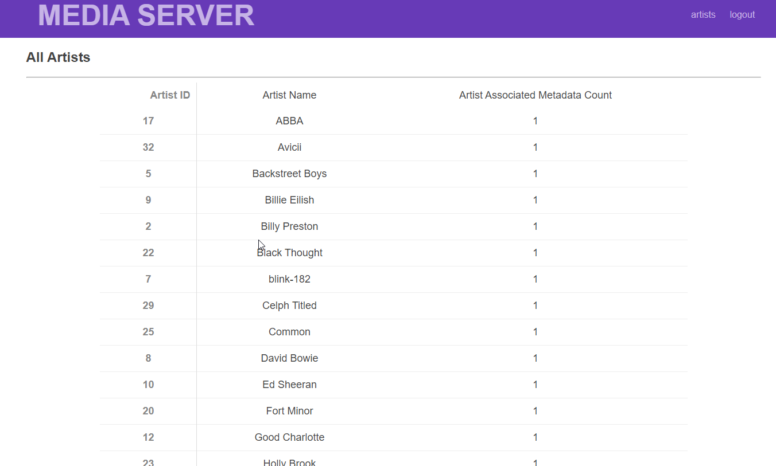
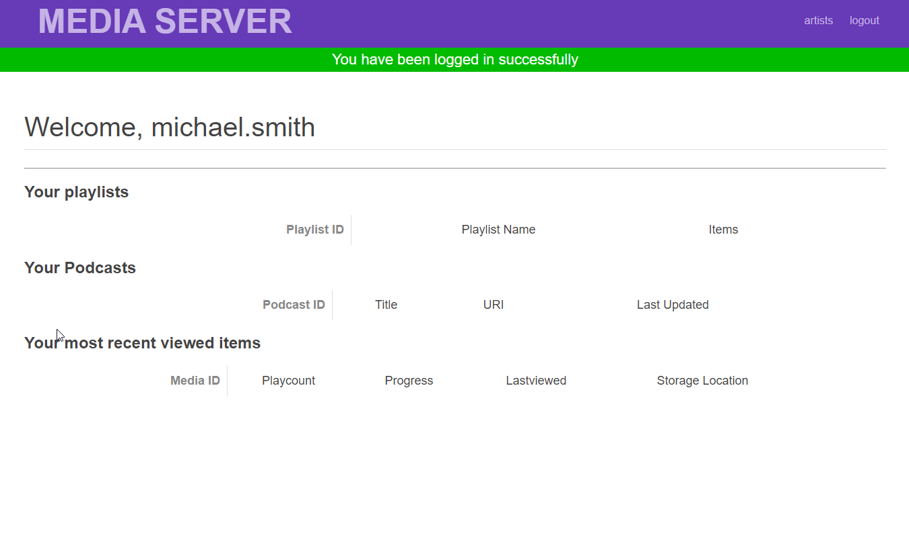
What it looks like

Slide 8
Specific Tasks – Database Tasks in ‘database.py’
Write SQL for getting/checking all relevant details needed to log a user into the system
Write SQL for getting all relevant details for a single song
Write SQL for getting Wall relevant details for all TV Shows along with their episode counts
Write SQL for getting all relevant details for a single TV Show and it’s episodes
Write SQL for getting all songs in an Album and their artists
Write SQL for getting all relevant details for a single podcast episode
Write SQL for getting all relevant details for a Podcast entity
Write SQL function for ensuring a proper insert of a new Song
Write SQL for getting all relevant details for searching through all Movies
Write SQL for getting all relevant details for a single genre

Slide 9
Specific Tasks – ‘routes.py’ Data handling
Handle data connections for a single podcast episode
Handle data connections for a Podcast entity
Handle data connections for adding a new Song
Handle data connections for searching through all Movies
Handle data connections for a single genre

Slide 10
Specific Tasks – ‘Templates/*.html’ Data Rendering
Handle display/rendering for a single podcast episode
Handle display/rendering for a Podcast entity
Handle display/rendering for adding a new Song
Handle display/rendering for searching for a Movie
Handle display / rendering for a single Genre

Slide 11
Recommendations for the extension portion
User Management (all of the options, not just one)
Updating password / adding a new user / new contact details
New Multi term Search Functionality
Advanced:
Implementing Fuzzy search along with Auto complete
Integrating a web-player to actually play content
Including keeping track of progress when player is halted or closed.
Build a ML recommender system using genres with both
User specific recommendations using User playlists and progress (on the landing page)
Generic recommendations (based on each item page)

Slide 12
Where can I find more help?
Canvas Week 09 Tutorial
https://canvas.sydney.edu.au/courses/36095/modules
We have included the solutions (in week 10) – but fair warning, the solutions also used an example of code that was vulnerable to SQL injection. Make sure your code uses parameterised SQL.
Python
https://www.w3schools.com/python/
Flask
https://www.fullstackpython.com/flask.html
Templates: https://www.tutorialspoint.com/flask/flask_templates.htm
PG8000
https://www.programcreek.com/python/example/96338/pg8000.connect
HTML
https://www.w3schools.com/

Slide 13
How to set-up
Download the code base or clone it from the GitHub repository
Unzip into a directory
Update ‘config.ini’ with your unikey and SID
Use a postgres client to open and run ‘mediaserver-schema.sql’
Use a postgres client to open and run ‘mediaserver-sampledata.sql’
On Windows
Install Windows Subsystem for Linux (WSL)
Add a Ubuntu kernel
Open a bash terminal
Run ./run.command
On Mac / Linux
Run ./run.command
Open ‘127.0.0.1:5000’ on a browser to access the webserver client side

Slide 14
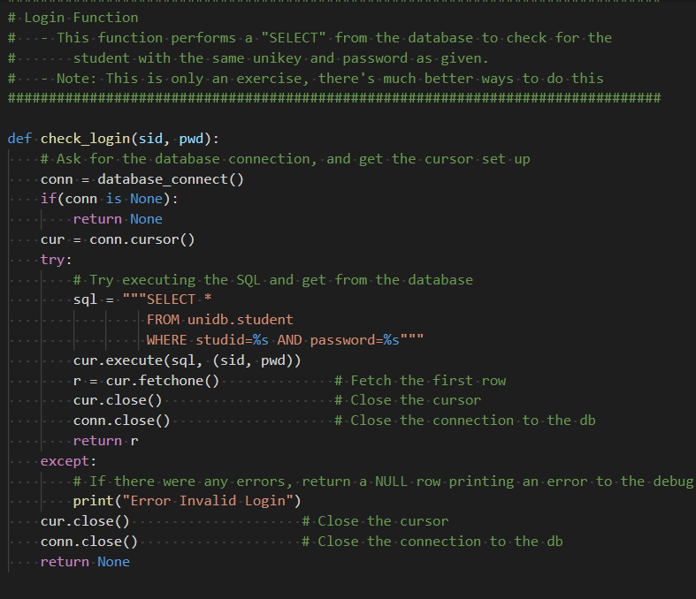
Thanks for the info but how do I even start?!
Task 1 begins with creating a login script
Let’s have a look at the week 09 tutorial.
That seems to be doing everything we need!

Slide 15
Starting …
We just need to change the table and schema names to be correct for the assignment.
So the SQL would be:
```
Select *
FROM mediaserver.UserAccount
Where username=‘%s’
AND
password=‘%s’;```

Slide 16
… And that’s Task 1a Finished!
You can now log in.
Have a look at some sample data to find some user names.

Slide 17
Files to Load
First Load ‘mediaserver_schema.sql’
After running that, load ‘mediaserver_sampledata.sql’

